Slide 1
How to adjust dependencies on Web Architecture
with AWS Services
Sumin Kim
AWS Cloud Clubs Captain (Student)
Kyung hee university (Korea)
Notes:
Hello, everyone My name is Sumin kim I’m AWS Cloud clubs captain of kyung hee univ in korea now. I’m interested in devops so Im studying container, aws, terraform and so on. Today I will talk problem that I experienced about how to adjust dependencies on Web architecture with AWS services.

Slide 2
What do we focus on ?
Notes:
Before starting, let’s talk about what we will focus on today.

Slide 3
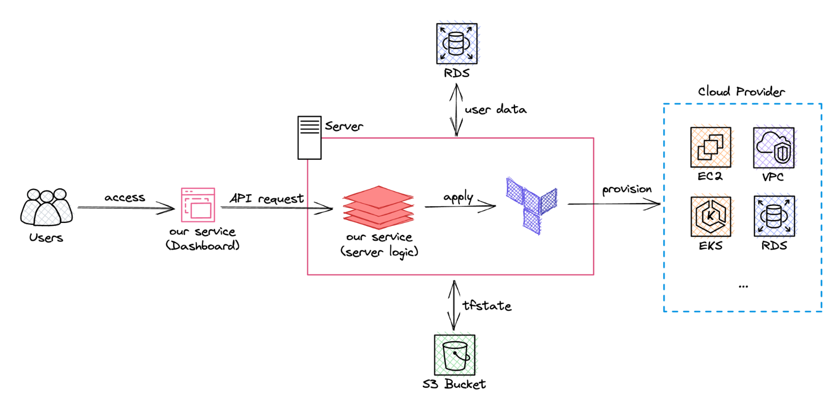
What do we focus on?
Dependency problem!!
Notes:
We are developing a web service that provisions cloud resources by configuring aws architecture through visual programming. Today I will focus on how we have solved it when we face the dependency problem between aws services on the web and what I felt during solving the problem.

Slide 4
What is how to adjust dependencies ?
Notes:
Okay let’s talk about what is how to adjust dependencies!

Slide 5
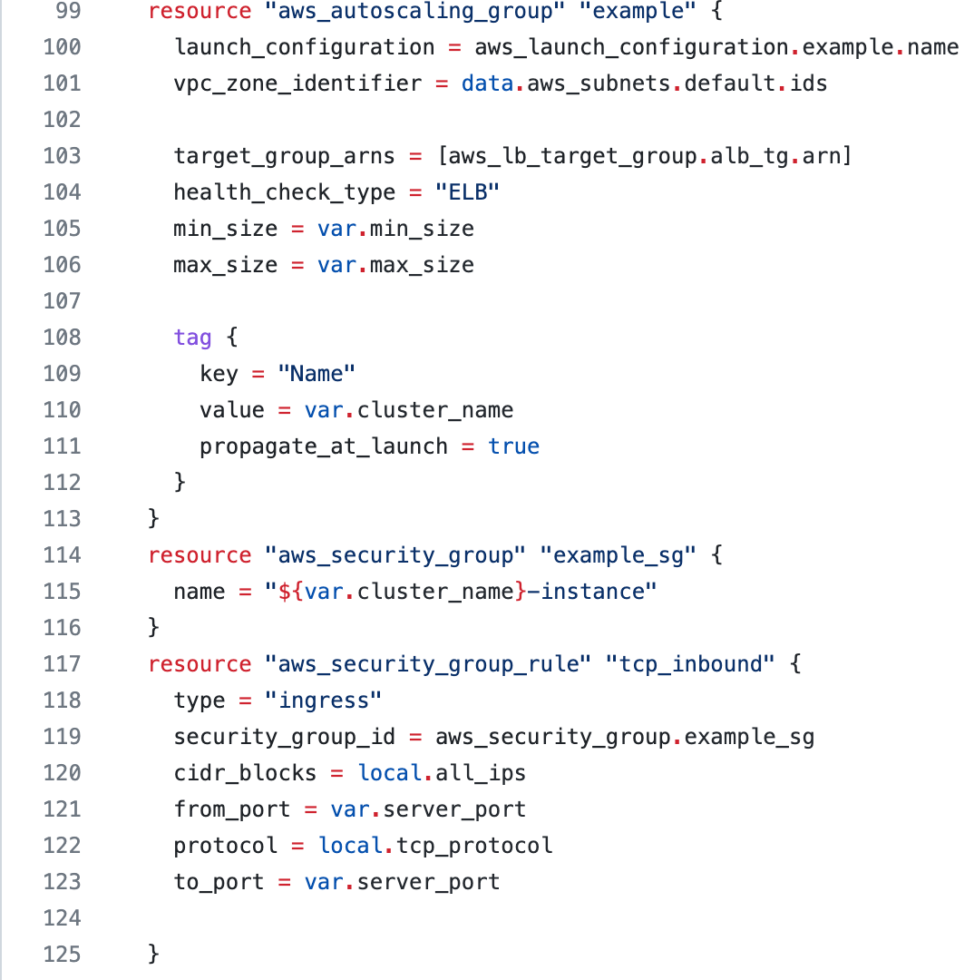
What is how to adjust dependencies ?
Terraform example
Notes:
Our main service is to replace the web architecture into terraform files for provisioning, and in the case of terraform, if you hand over the value like vpc_zone_identifier to the variable in the aws autoscaling group resource, the infrastructure is deployed in order according to the dependency when you execute the command terraform apply.

Slide 6
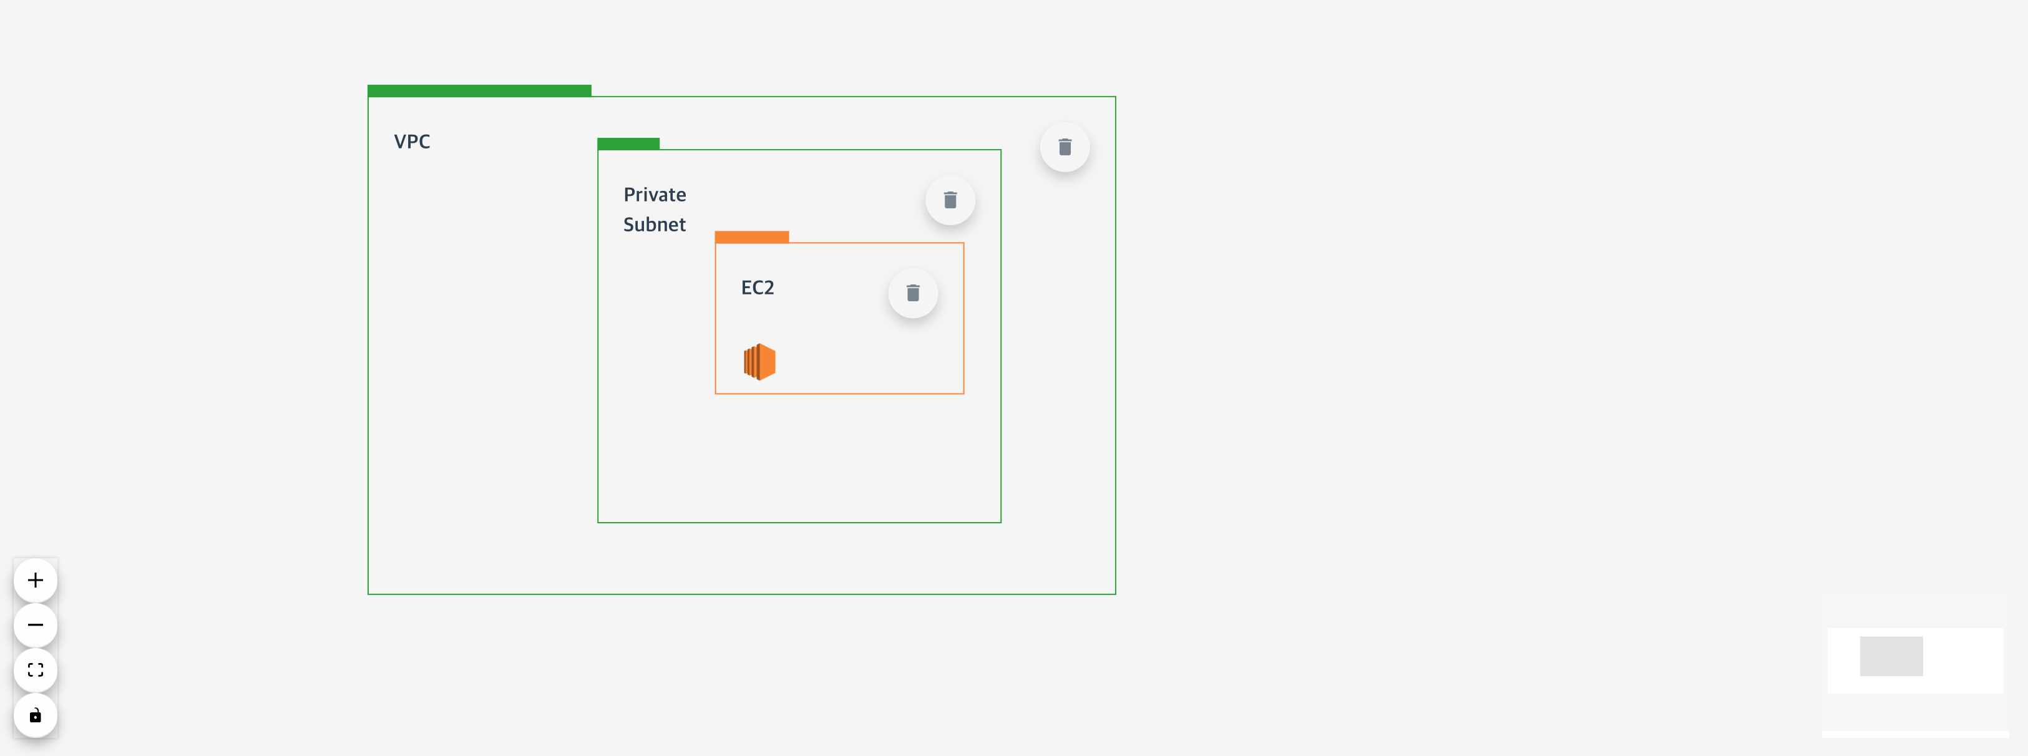
What is how to adjust dependencies ?
Correct
Notes:
However, since the web architecture does not automatically establish dependencies like this, it is up to the user to establish dependencies between resources. Users who understand the configuration well such as above, can deploy resources well

Slide 7
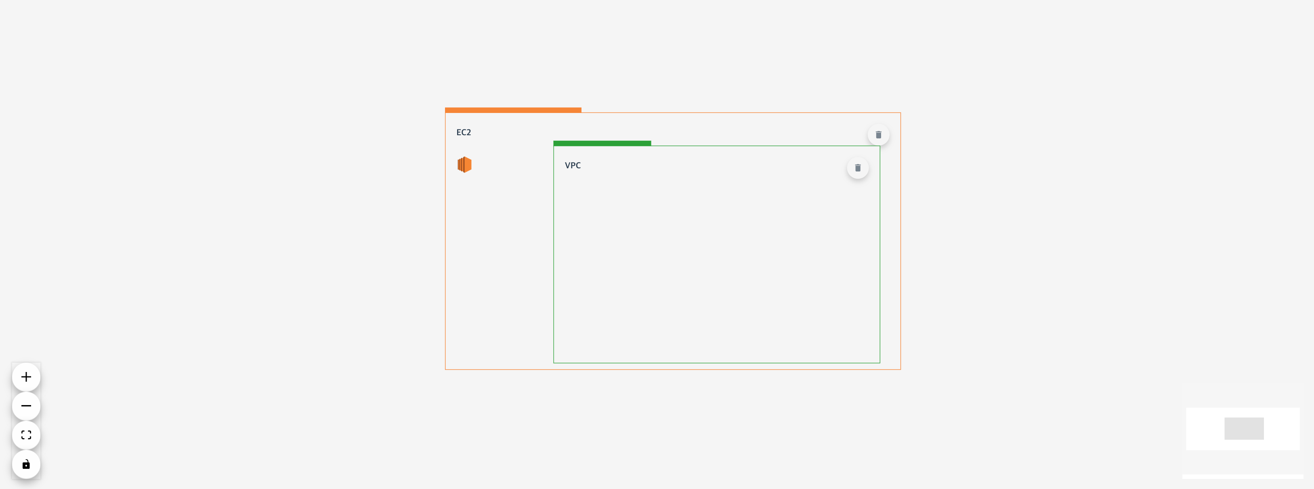
What is how to adjust dependencies ?
Not correct
Notes:
but users who are not familiar with it are likely to deploy them incorrectly, such as above. We considered this to be a fatal problem with services that could cause errors due to misconfiguration of the infrastructure.

Slide 8
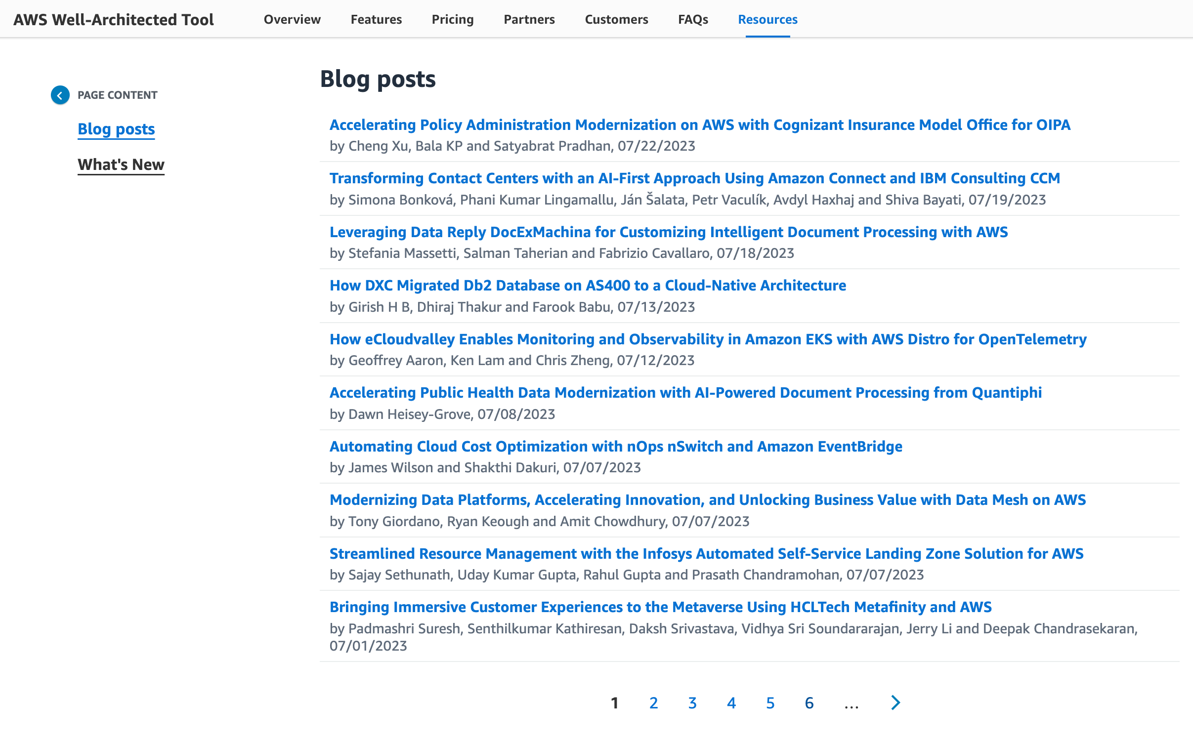
What is how to adjust dependencies ?
Well-known Architecture
Notes:
So we have conducted various discussions and investigations to solve this problem, and since aws have well-known architectures and templates, we decided to refer to them to adjust the dependencies,

Slide 9
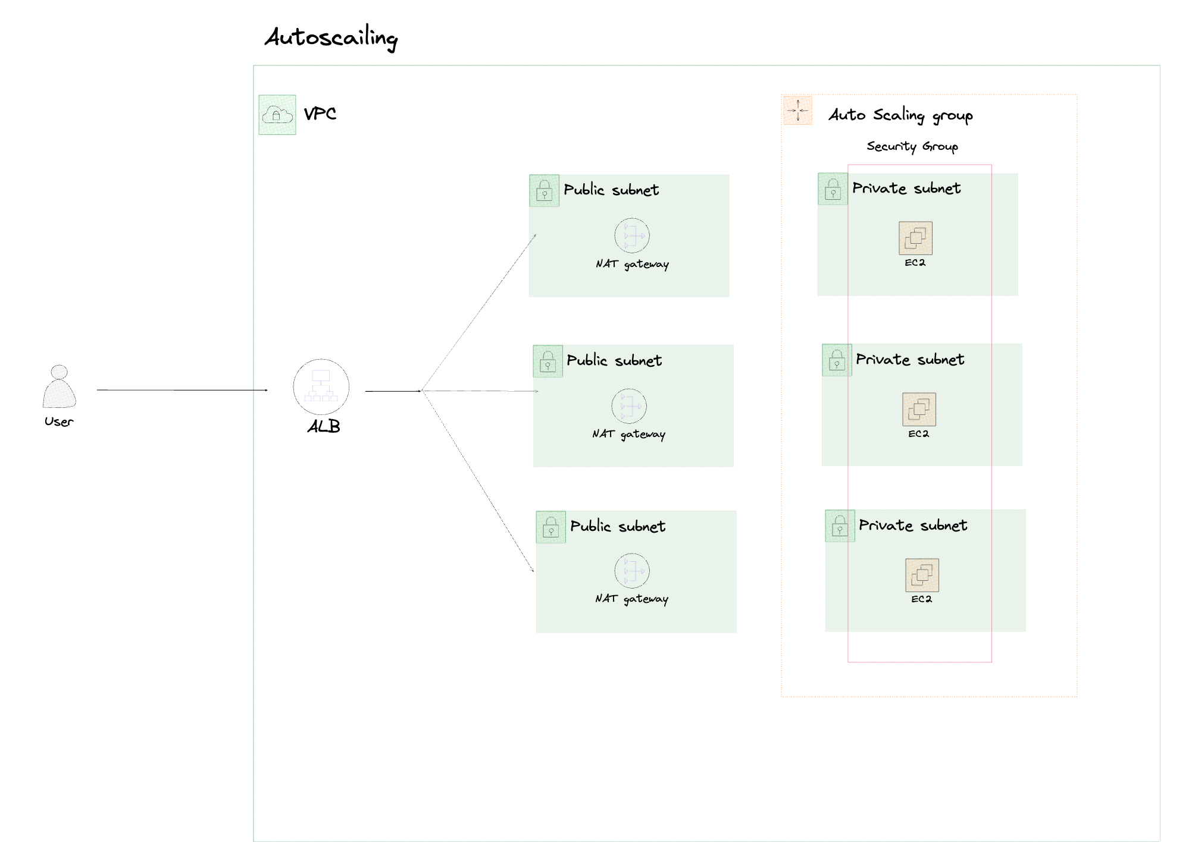
What is how to adjust dependencies ?
Basic application architecture
Notes:
we adjusted dependencies using the most basic application distribution architecture through asg and alb. And now we are adjusting the application distribution architecture like aws eks. Of course, it was necessary to adjust the dependencies between all resources, but we focused on completing the applications in a given time and decided to apply the overall dependencies based on the dependencies belonging to the architecture.

Slide 10
Key points
Notes:
There is one key point that I felt while solving problems such as this dependency problem while working on the project.

Slide 11
Key points
Do not try to solve it all at once,
just one by one !!
Notes:
It's about solving it one by one rather than trying to solve it all at once, if you try to solve everything at once, you get tired easily and often give up in the middle. So rather than trying to solve the problem as a whole at once when you're in a problem situation, I think it's better to focus on the minimum problems you have to solve one by one to help keep the project running.

Slide 12
Sumin Kim
sumink@gmail.com
Instagram: suminn0
Github: Eeap
LinkedIn: Eeap
Notes:
Thanks for listening to my presentation! I hope this is useful for you and you have any questions contact me with these social media!

